Slide 1
Chat Application
Presented by,
Salvi Vinit Vivek
Shirdhankar Prathamesh Pradyumna
Surve Rushikesh Shekhar
Under Guidance of
Prof. Onkar Dike
30 September 2024

Slide 2
Introduction
Chat applications enable real-time communication between users.
Our project is a real-time chat application that allows seamless communication.
Why we chose this project:
It combines key technologies: web development, real-time communication, and database management.
Provides experience in Socket.io for real-time data transfer.
Objective: To gain hands-on experience with full-stack development by creating a functional chat system.

Slide 3
Technology Stack
Frontend - React:
For building the user interface and handling client-side logic.
Backend - Node.js and Express.js:
Node.js: For executing server-side JavaScript.
Express.js: Lightweight web framework for handling HTTP requests and routing.
Database - MongoDB:
NoSQL database for storing user data and chat messages.
Real-time Communication - Socket.io:
Enables real-time, bidirectional communication between client and server.

Slide 4
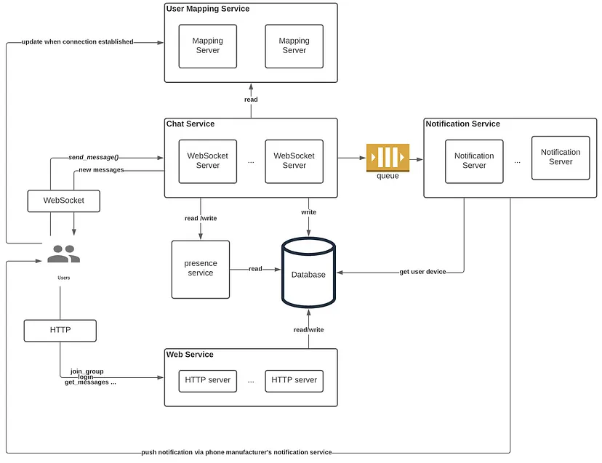
Generic Architecture

Slide 5
Features
Real-time Messaging: Instantly send and receive messages using Socket.io for real-time communication between users.
User Authentication: Secure login and registration system to authenticate users before accessing the chat.
Message Storage: All messages are saved in MongoDB, allowing users to view chat history.
Responsive User Interface: Built with React to ensure smooth user interaction across different screen sizes.

Slide 6
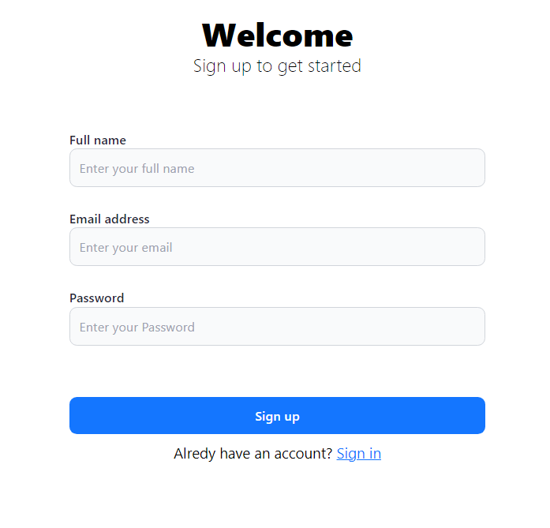
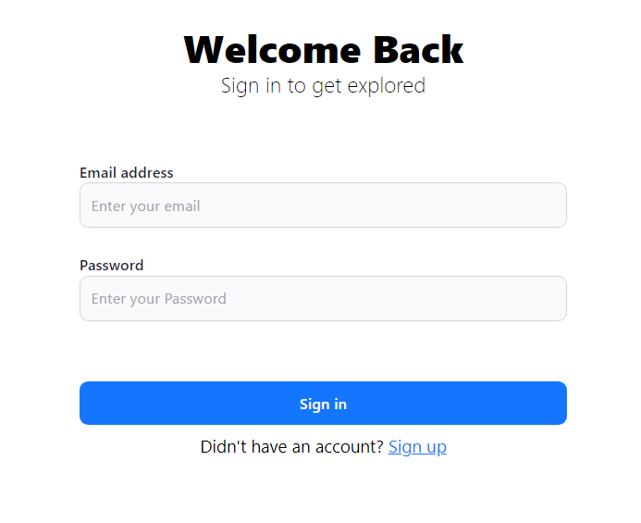
Implementation
Sign Up page
Sign in page

Slide 7
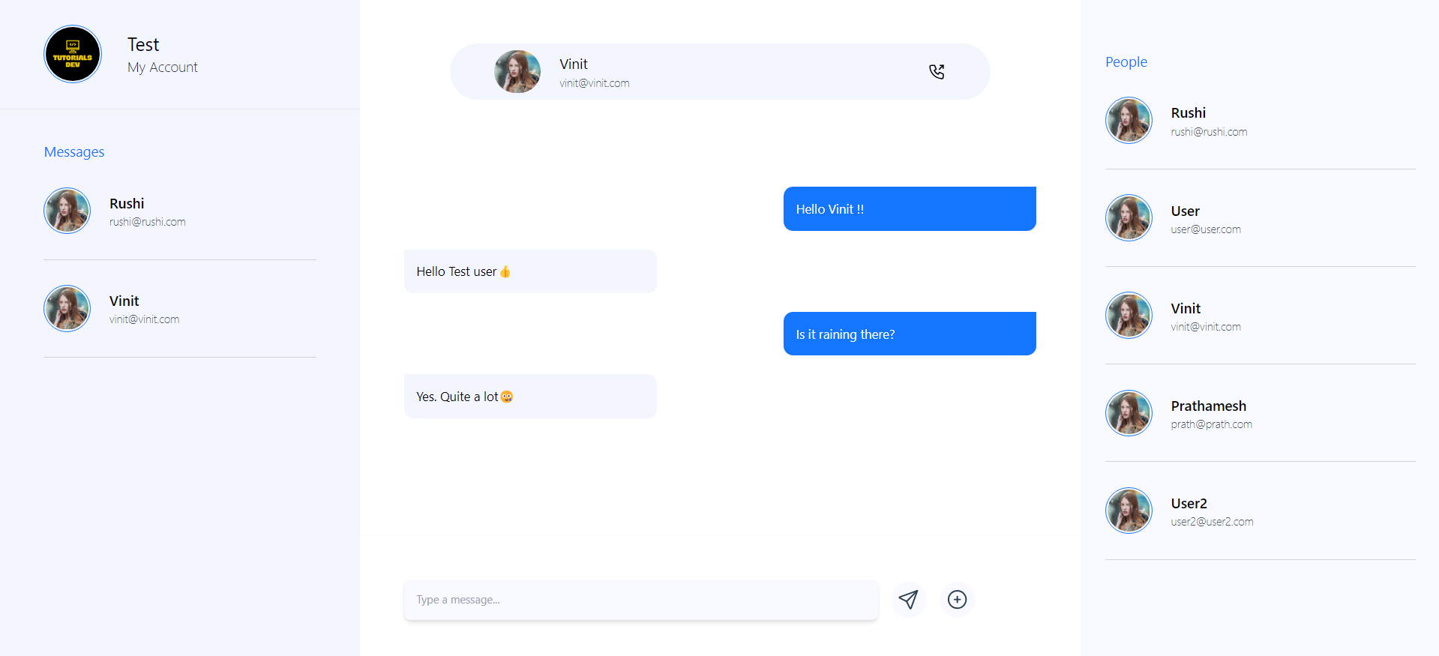
Implementation
User 1 chat screen

Slide 8
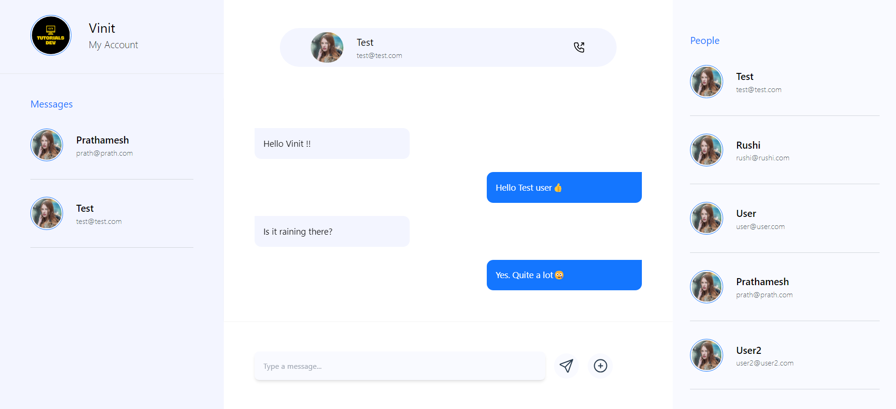
Implementation
User 2 chat screen

Slide 9
Challenges Faced
Database Integration: Encountered difficulties in connecting the MongoDB database to the backend, ensuring proper data flow and management.
Version Compatibility: Faced challenges with compatibility issues between different versions of technologies (e.g., Node.js, Express.js, and MongoDB), which affected development and functionality.
Integrating Socket.io: Implemented real-time communication using Socket.io, dealing with issues related to connection stability and message synchronization across clients.
User Interface Responsiveness: Ensuring the user interface built with React was responsive across various devices, requiring extensive testing and adjustments.

Slide 10
Future Scope
Notification System: Implementing real-time notifications to alert users when a new message is received, even when they are not actively using the chat window.
Multimedia Sharing: Adding functionality to allow users to send and receive multimedia content such as images, videos, and documents.
Message Deletion: Introducing the option for users to delete their own messages, either for themselves or for everyone in the chat.
Account Settings Management: Allowing users to edit their profile settings, such as updating their display name, password, or profile picture.
Group Chat Functionality: Extending the app to support group chats, where multiple users can communicate together in a single conversation.

Slide 11
Conclusion
We developed a real-time chat application functionality, gaining valuable experience in full-stack development with React, Node.js, Express.js, MongoDB, and Socket.io. We successfully implemented core features like messaging and user authentication, and we plan to enhance the app with functionalities such as multimedia sharing, notifications, and group chat. This project has deepened our understanding of web application development and real-time communication technologies.

Slide 12
References
Documentation
React: react.dev
Node.js: nodejs.org
Express.js: expressjs.com
MongoDB: mongodb.com/docs
Socket.io: socket.io/docs
Tutorials & Articles
Online tutorials from YouTube and relevant blogs on chat app development.
Generative AI tools
Particularly useful for debugging

Slide 13
Thank You !!

